Slide 1

Sprocket Central Pty Ltd
Data Analytics Approach

Slide 2
Agenda
Pre-Analysis Introduction:
Gain your approval for our methodologies and process.
Essential reference before delving into detailed strategy.
Phases Overview:
Data Exploration: Understand data distributions.
Model Development: Feature engineering, data transformations, and modeling.
Interpretation: Result interpretation and reporting.
Propel strategic business growth.
Contextual Challenge:
Our challenge: 1000 potential customers, no transaction history.
Marketing team aims to boost business via data analysis.
Goal: Uncover insights to optimize targeted marketing resource allocation.
Strategic Objective:
Leverage analysis to reveal customer trends and behavior.
Enhance performance through focus on high-value customers.

Slide 3
Agenda
Approach Followed for Data Analysis :
Age Distribution w.r.t Gender
Bike Purchases (Past 3 Years)
Job Industry
Cars owned: State-wise Distribution

Slide 4
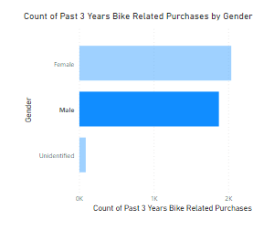
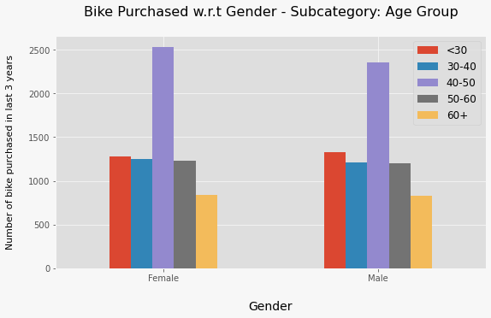
Data Exploration : Age Distribution & Bike Purchases
Predominant age groups among new customers: 40-49, 50-59, and 60-69.
Fewer customers in age groups 10-19 and 90-99, for evident reasons.
Data highlights a substantial number of bike purchases in the last 3 years within the 40-50 age group, with a slightly higher female ratio.
Marketing and advertising focus recommendation: Prioritize females within the target audience.

Slide 5
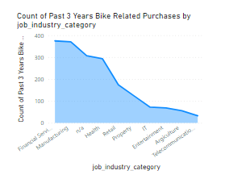
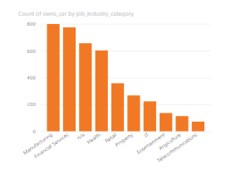
Data Exploration : Job Industry
Financial Services, Manufacturing, and Health are the top three item selling industries, followed by Retail and Property.
Similar industries also stand at the top with respect to cars owned as seen in the second chart.

Slide 6
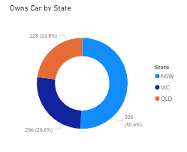
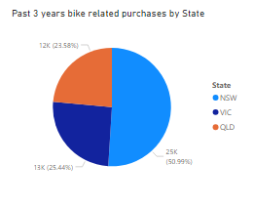
Data Exploration : State-wise Distribution
Potential Market Opportunities:
New South Wales identified as a promising market among three states.
In New South Wales, the number of vehicle owners is nearly equal to non-vehicle owners, suggesting significant potential for valuable customers.
Market Insights for VIC and QLD:
VIC and QLD have a higher proportion of customers owning cars compared to non-vehicle owners.
Strategic initiatives can be explored to encourage car owners in VIC and QLD to consider purchasing bikes.

Slide 7
Model Development
Prioritizing High-Value Clientele:
Highlighting key segments for targeted efforts within the new list:
Focus on individuals aged between 40 and 50.
Note a predominance of high-value female customers compared to males.
Concentrate efforts on clients employed in Financial Services, Manufacturing, and Health sectors.
Prioritize clients currently residing in New South Wales and Victoria.

Slide 8
Interpretation
SUMMARY TABLE FOR HIGH VALUE CLIENTELE
Customer ID | Bike related purchases for the past 3 years | Age | Job Industry | Wealth Segment | Owns Cars | State
650 | 486 | 44 | Health | Mass Customer | No | New South Wales
1842 | 445 | 44 | Financial Services | Mass Customer | No | New South Wales
50 | 266 | 41 | Manufacturing | Mass Customer | Yes | New South Wales
3297 | 234 | 46 | Manufacturing | Mass Customer | No | Victoria
2001 | 168 | 44 | Manufacturing | Mass Customer | Yes | New South Wales

Slide 9
THANK YOU!

